Slide 1
33 references to support professional identity formation in undergraduate and postgraduate education
in family medicine
_____________________________________________________________
Wolfram Arends, Jan Alexander Schwab,
MVZ München Süd-Harras,
Academic teaching center of Ludwig Maximilian University, Munich
Albert Roßhaupterstr. 2, 81369 München
info@medizin.one
Herzlich Willkommen

Slide 2
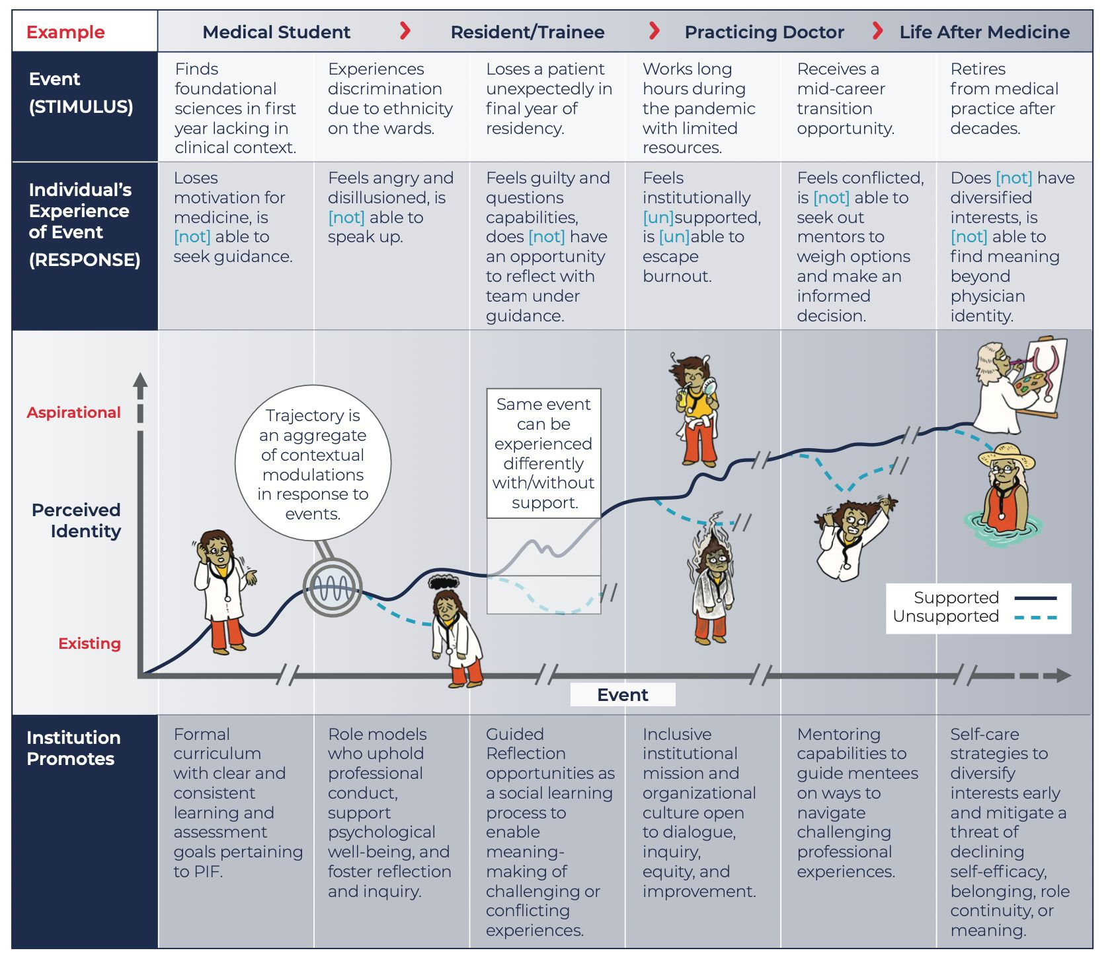
Herzlich Willkommen

Slide 3


Background
PIF
Background
Material and Methods
Results
Sumary
Literature
Personal identity formation (PIF)
central importance in medical studies and further training.
multifactorial phenomenon.
must be supportet by medical teacher systematically / strategically.
merge clinical /non-clinical experiences, expectations.
Combine environmental factors with individual values.
Merge beliefs and obligations.
evolves relationship between students.
evolves PIF identity and self-identity.
Medical training
imparts specialist knowledge and skills.
important for medical socialization proces
Good university hospitals
offer structured curricula
provide clearly defined training content
After final exam, young doctor lacks essential skills and basic competencies
for communication with patients, senior physicians, nursing staff, and colleagues.

Slide 4
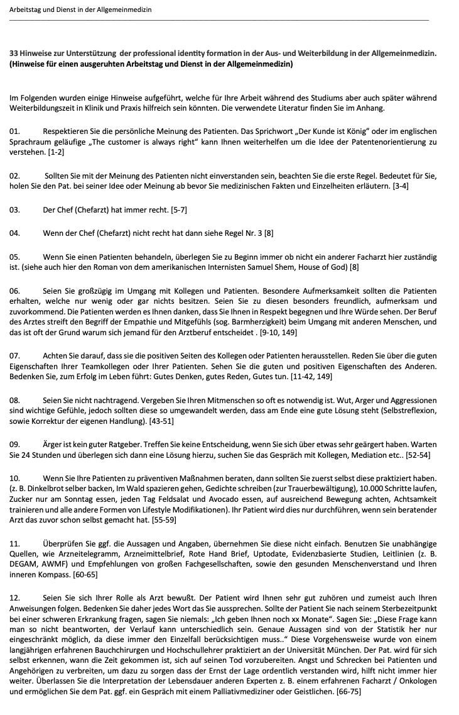
Material and Methods
33 Rules have been established for the working day in clinics and practices
Information on behavior in the hospital and in the doctor's office.
Dealing with employees in a team
Scientific work
Acquiring skills
Background
Material and Methods
Results
Sumary
Literature

Slide 5
Material and Methods
33 references to support professional identity formation in medicine
Background
Material and Methods
Results
Sumary
Literature
1 Always respect Patient opinion.
2 If Patient is wrong , look rule No.1
3 The Chief Doctor is always right.
4 If the Chief is not right, look No. 3
5 Before start, look if patient is your case.
6 Be generous to patient and collegues.
7 Think good, talk good, do good.
8 Practice forgivness.
9 Anger is never a good advisor. Think before.
10 Practice health ideas before recomend to Patient.
11 Check statments using independent sources.
12 Be aware of words before talking to the patient
13 Be loyal and respectful to superiors or collegues.
14 Trust your personal impression.
15 Let the patient finish speaking.
16 Switch of your mobile during work.
17 Log your mistakes and learn from them.
18 Understand the culture/history of other countries.
19 Never lough at a patient or collegue.
20 Know yoursef. It helps training self reflection.
21 Understand the theme of placebo and nocebo.
22 Be friendly with people of other countries.
23 Know the birthday of your collegues.
24 Read Scientific Journals and papers.
25 Those who publish will stay in the job.
26 Write Case history.
27 Always learn something from your colegue.
28 Dont see others as competitors.
29 Stick together, Medicine is a big job.
30 Be patient with yourself, sef doubt is for training.
31 Dont compare yoursef with collegues.
32 Join early scientific society and boards.
33 meeting is no self-promotion but for finding solutions.

Slide 6
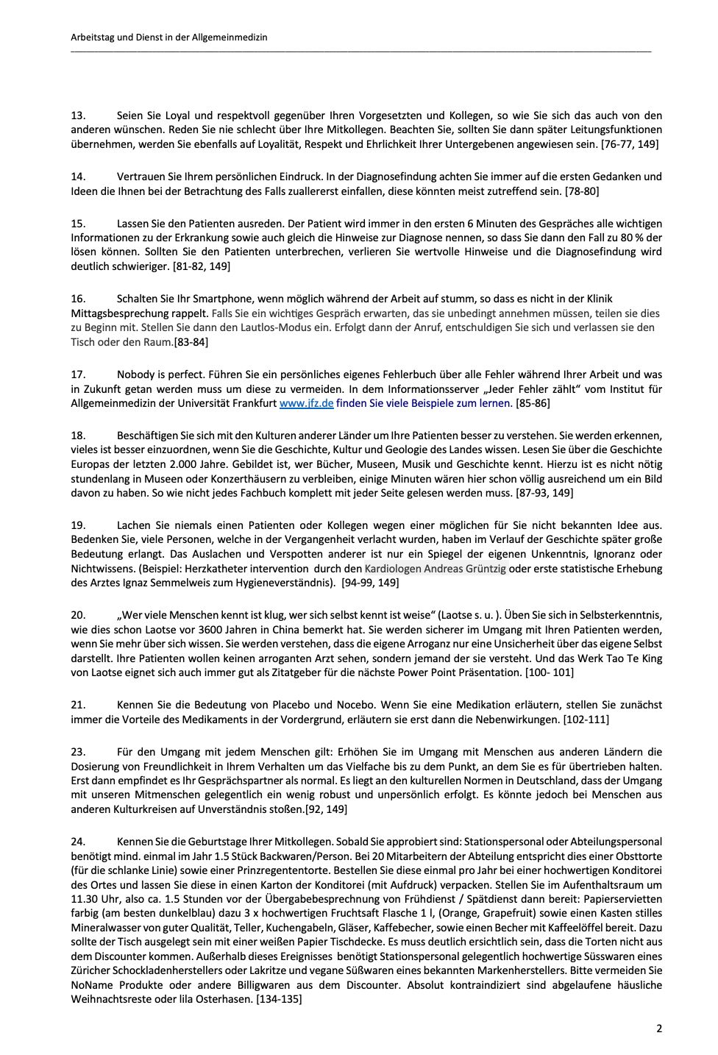
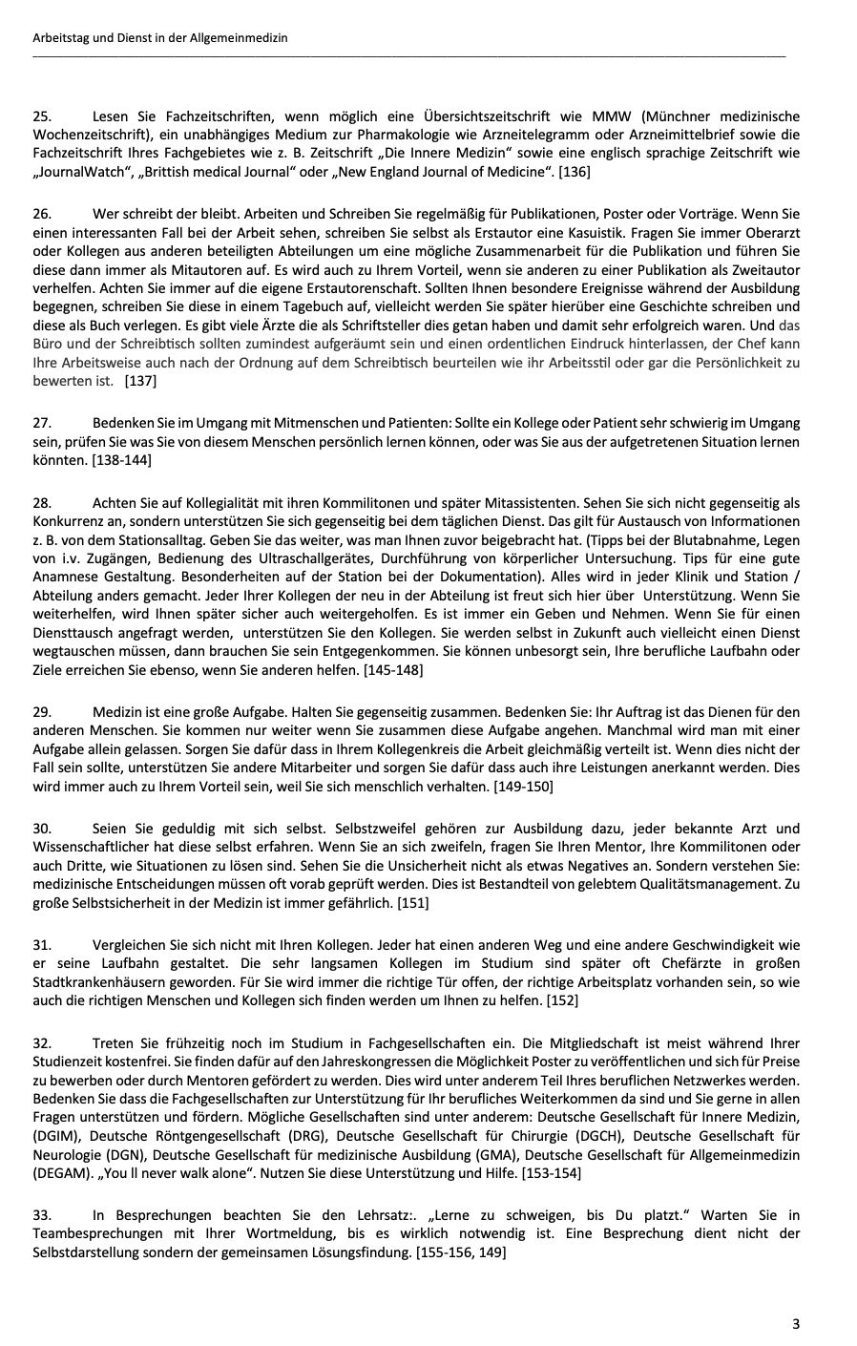
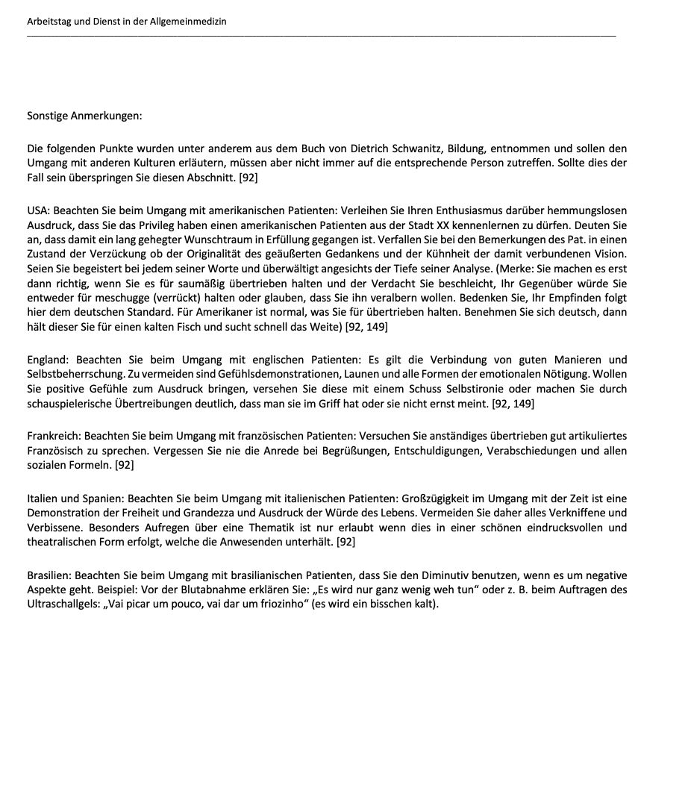
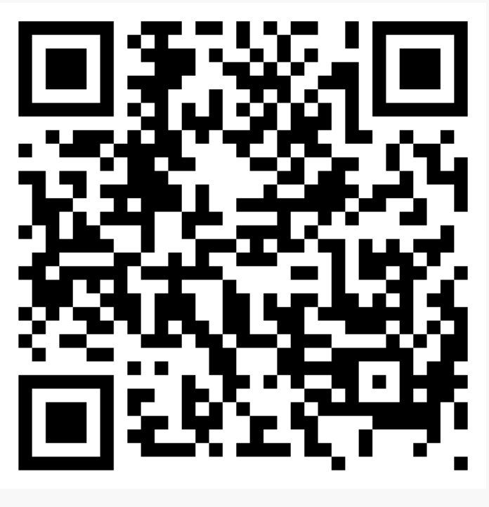
Download „33 references“
www.professional-formation.de
info@medizin.one

Slide 7
Trifft nicht zu
Trifft zu
The text of the 33 rules was easy to read.
The text of the 33 rules was sometimes
difficult to understand.
The text of the 33 rules uses
simple language.
I liked the text of the 33 rules.
The text of the 33 rules can facilitate work in
hospitals, in the ward or outpatient clinic
/ functional departments.
While reading the 33 rules,
I could hardly put it down.
While working on the text
for the 33 rules, I had the feeling
that I had to force myself to work.
I would recommend the text for the 33 rules
to others.
Herzlich Willkommen

Slide 8
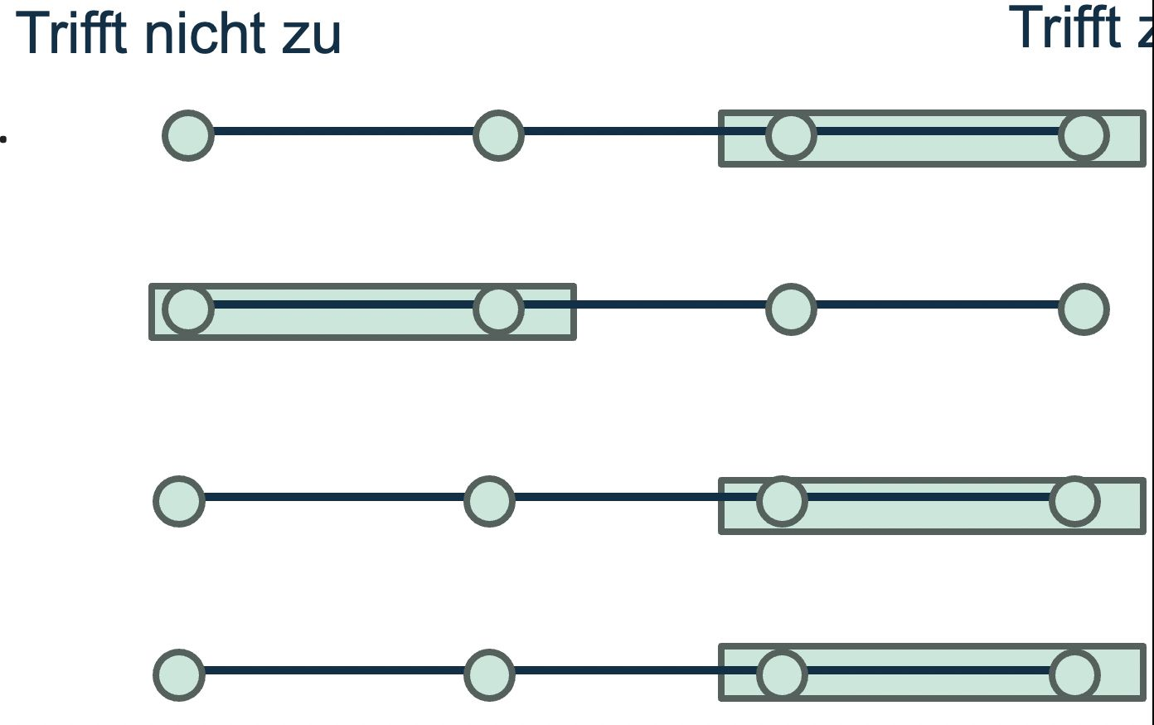
Results
Background
Material and Methods
Results
Sumary
Literature
Formulation too general in parts
Good results for extrinsic and intrinsic motivation.

Slide 9
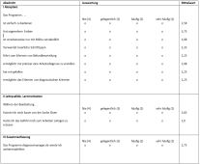


Summary
PIF
33 references “nice to have” for work in clinic and doctor's office, Tools for training to transfer knowledge
Background
Material and Methods
Results
Sumary
Literature
Download „33 references“
http://www.professional-identity-formation.org
info@medizin.one

Slide 10
Literature
PIF
Background
Material and Methods
Results
Sumary
Literature
Füeßl , S, Was Assistenzärzte leider nicht lernen, MMW-Fortschr. Med. 2015; 157 (3)
Günes, Dennis, Patientenorientierung: Ausgezeichnet Dtsch Arztebl 2014; 111(5): A-179 / B-157 / C-151
Howard L et al. Medical training: some „forgotten“ common competencies. BMJ. 2014;349:g7384
GE Miller, The assessment of clinical skills/competence/performance. Acad Med. 1990 Sep;65(9 Suppl):S63-7. doi: 10.1097/00001888-
Sarraf-Yazdi S et al. , Conceptualizing Professional Identity Formation in Medicine, Acad Med 2024 Mar 1;99(3):343.

